Slide 1
CLUSTERING

Slide 2
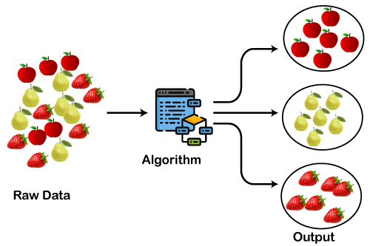
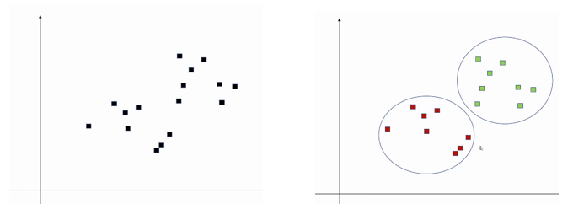
CLUSTERING
Clustering is the broad set of techniques for finding subgroups or clusters on the basis of characterization of objects within dataset such that objects with groups are similar but different from the object of other groups.
Primary guideline of clustering is that data inside a cluster should be very similar to each other but very different from those outside clusters.

Slide 3
Why Clustering?
Clustering is very much important as it determines the intrinsic grouping among the unlabelled data present.
It helps to discover hidden patterns, reduce noise, simplify data, and identify outliers in the data
It classifies data into structures that are more easily understood and manipulated.
There are no criteria for good clustering.
It depends on the user, and what criteria they may use which satisfy their need.
For instance, we could be interested in finding representatives for homogeneous groups (data reduction), finding “natural clusters” and describing their unknown properties (“natural” data types), in finding useful and suitable groupings (“useful” data classes) or in finding unusual data objects (outlier detection).

Slide 4
TYPES OF CLUSTERING TECHNIQUES Partitioning Method
Uses mean or mediod to represent cluster center
Adopts distance-based approach to refine clusters
Finds mutually exclusive clusters of spherical / nearly spherical shape
Effective for datasets of small – medium age
Example: k-means and k-medoids technique (partitioning around medoids algorithm)

Slide 5
TYPES OF CLUSTERING TECHNIQUES Hierarchical Method
Creates tree-like structure through decomposition
Uses distance between nearest or furthest points in neighboring clusters for refinement
Error can’t be corrected at subsequent levels
Agglomerative Clustering: It uses a bottom-up approach. It starts with each object forming its own cluster and then iteratively merges the clusters according to their similarity to form large clusters. It terminates either
When certain clustering condition imposed by user is achieved or
All clusters merge into a single cluster
Divisive Clustering: It uses the top-down strategy, the starting point is the largest cluster with all objects in it and then split recursively to form smaller and smaller clusters. It terminates when the user-defined condition is achieved or final clusters contain only one object.

Slide 6
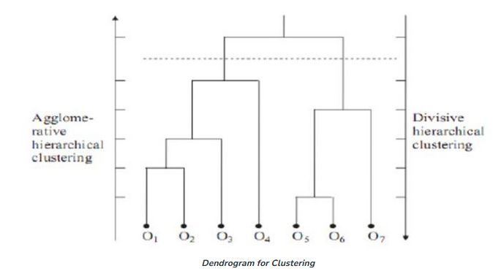
HIERARCHICAL METHOD Dendrogram
A dendrogram, which is a tree like structure, is used to represent hierarchical clustering. Individual objects are represented by leaf nodes and the clusters are represented by root nodes.

Slide 7
TYPES OF CLUSTERING TECHNIQUES Density Based Method
Useful for identifying arbitrarily shaped clusters
May filter out outliers
DBSCAN (Density-Based Spatial Clustering of Applications with Noise) is a popular clustering algorithm used for data analysis and pattern recognition. It groups data points based on their density, identifying clusters of high-density regions and classifying outliers as noise

Slide 8
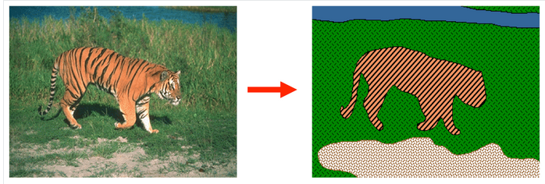
Applications
Customer Segmentation: Customers are categorized by using clustering algorithms according to their purchasing behavior or interests to develop focused marketing campaigns.
Retail Clustering: There are many opportunities for clustering in retail businesses. For example, you can gather data on each store and cluster at store level to generate insights that may tell you which locations are similar to each other based on attributes like foot traffic, average store sales, number of stock keeping units, etc.
Clustering in Clinical Care or Disease Management: Clustering laboratory data for 101 patients and then segmented them into 3 clusters. Each cluster was represented by different conditions. For example, cluster 1 has patients with Low WBC & CRP. Cluster 2 has patients with High BMP & Serum, and Cluster 3 has patients with Low Serum.
Image Segmentation: This type of clustering is useful if you want to isolate objects in an image to analyze each object individually to check what it is.

Slide 9
Applications
Marketing: It can be used to characterize & discover customer segments for marketing purposes.
Biology: It can be used for classification among different species of plants and animals.
Libraries: It is used in clustering different books on the basis of topics and information.
Insurance: It is used to acknowledge the customers, their policies and identifying the frauds.
City Planning: It is used to make groups of houses and to study their values based on their geographical locations and other factors present.
Earthquake studies: By learning the earthquake-affected areas we can determine the dangerous zones.

Slide 10
Applications
Image Processing: Clustering can be used to group similar images together, classify images based on content, and identify patterns in image data.
Genetics: Clustering is used to group genes that have similar expression patterns and identify gene networks that work together in biological processes.
Finance: Clustering is used to identify market segments based on customer behavior, identify patterns in stock market data, and analyze risk in investment portfolios.
Customer Service: Clustering is used to group customer inquiries and complaints into categories, identify common issues, and develop targeted solutions.
Manufacturing: Clustering is used to group similar products together, optimize production processes, and identify defects in manufacturing processes.
Medical diagnosis: Clustering is used to group patients with similar symptoms or diseases, which helps in making accurate diagnoses and identifying effective treatments.
Fraud detection: Clustering is used to identify suspicious patterns or anomalies in financial transactions, which can help in detecting fraud or other financial crimes.

Slide 11
Applications
Traffic analysis: Clustering is used to group similar patterns of traffic data, such as peak hours, routes, and speeds, which can help in improving transportation planning and infrastructure.
Social network analysis: Clustering is used to identify communities or groups within social networks, which can help in understanding social behavior, influence, and trends.
Cybersecurity: Clustering is used to group similar patterns of network traffic or system behavior, which can help in detecting and preventing cyberattacks.
Climate analysis: Clustering is used to group similar patterns of climate data, such as temperature, precipitation, and wind, which can help in understanding climate change and its impact on the environment.
Sports analysis: Clustering is used to group similar patterns of player or team performance data, which can help in analyzing player or team strengths and weaknesses and making strategic decisions.
Crime analysis: Clustering is used to group similar patterns of crime data, such as location, time, and type, which can help in identifying crime hotspots, predicting future crime trends, and improving crime prevention strategies.

Slide 12
REFERENCE
https://www.youtube.com/watch?v=ZOLYaa9Jex0
https://www.geeksforgeeks.org/clustering-in-machine-learning/

